Slide 1

Systematic co-variation of monophthongs across speakers of New Zealand English
James Brand, Jen Hay, Lynn Clark, Kevin Watson, Márton Sóskuthy
james.brand@canterbury.ac.nz
ICPhS, Melbourne 2019
Slides: https://tinyurl.com/icphs-covar

Slide 2
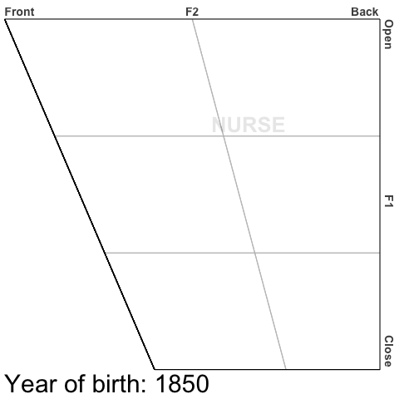
Background
Traditional approaches to studying language variation and change
Tended to focus on a single linguistic variable
e.g. nurse raising and fronting in NZE (Maclagan et al, 2017)
But... unclear whether an individual variable also co-varies with others

Slide 3
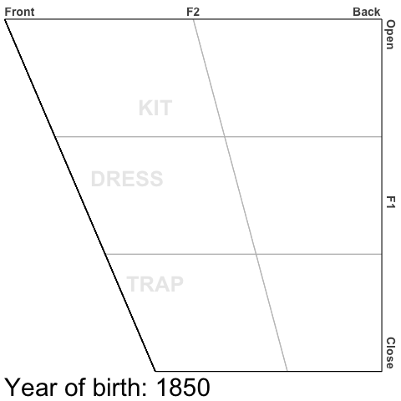
Background
Evidence of variation and change across multiple variables
Evidence for change where variables are not independent from one another
e.g. Short front vowel shift in NZE (Maclagan & Hay, 2007)
But... still not clear whether these changes exist simply at a community level or if it also exists within individuals
But… still not clear whether other sounds changes are also co-varying together

Slide 4
Background
Existing approaches to understanding co-variation
Recent empirical work has been limited by small speaker sizes or number of variables investigated
Suitability of the statistical approaches to gain a ‘full picture’ of how co-variation is operating
When investigating data with known sound changes, how do we explore co-variation whilst keeping the known predictors of change constant
On-going theoretical debate about how sets of variables might work together to create speaker styles – is a linguistic variable really an independent entity? (see Guy & Hinskens, 2016)

Slide 5
Research question 1
Are there systematic patterns across speaker’s realisations of combinations of vowels?
Prediction…
Yes... systematic variation is known to exist when we look at variables in isolation, but these variables rarely operate in isolation

Slide 6
Research question 2
Are there identifiable leaders of change who use combinations of innovative variants together?
Prediction…
Yes... it is plausible that a constellation of innovative variants are used by some speakers, whilst not at all by others

Slide 7
Method
Vowel | Freq
KIT | 259,788
SCHWA | 162,566
DRESS | 116,993
FLEECE | 73,806
STRUT | 70,721
THOUGHT | 58,676
LOT | 52,481
TRAP | 48,769
START | 44,842
GOOSE | 42,915
NURSE | 25,804
FOOT | 21,249
Total | 978,610
ONZE
Extract vowels
Measure F1/F2
Cleaning
600+ speakers
Born between 1851-1988
HTK force aligned
12 monophthongs
>2 million tokens
Mid-point
Lobanov normalised
Outliers and stopwords
Min 10 tokens per vowel per speaker

Slide 8
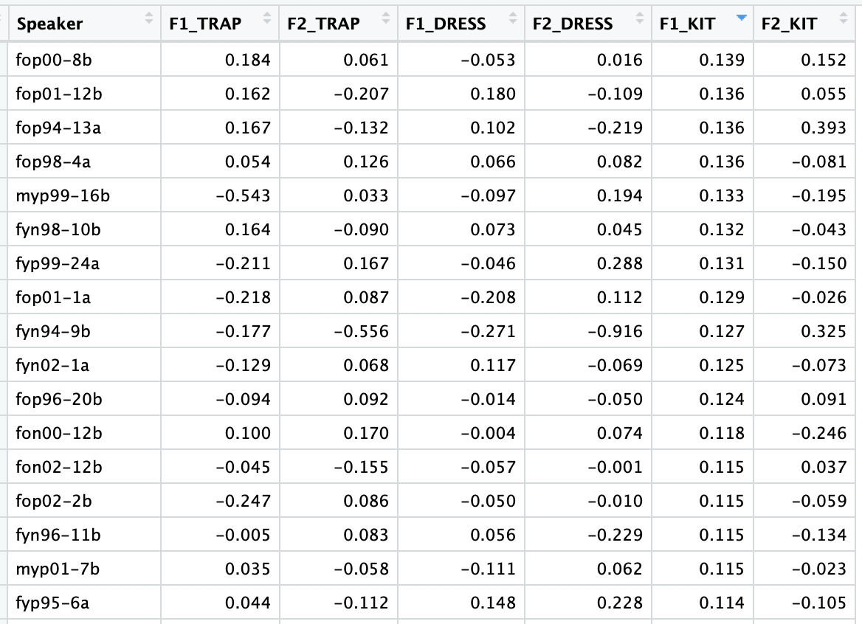
Analysis
Run 24 separate lmer models predicting each of the 12 vowel's normalised F1 or F2 values
lmer(F_value ~
The dependent variable
year_of_birth*gender + stress + speech_rate +
The variables we want to control for
(1|speaker) + (1|word))
The variable we are really interested in
Run a Principal Components Analysis on the resulting data set of speaker intercepts

Slide 9
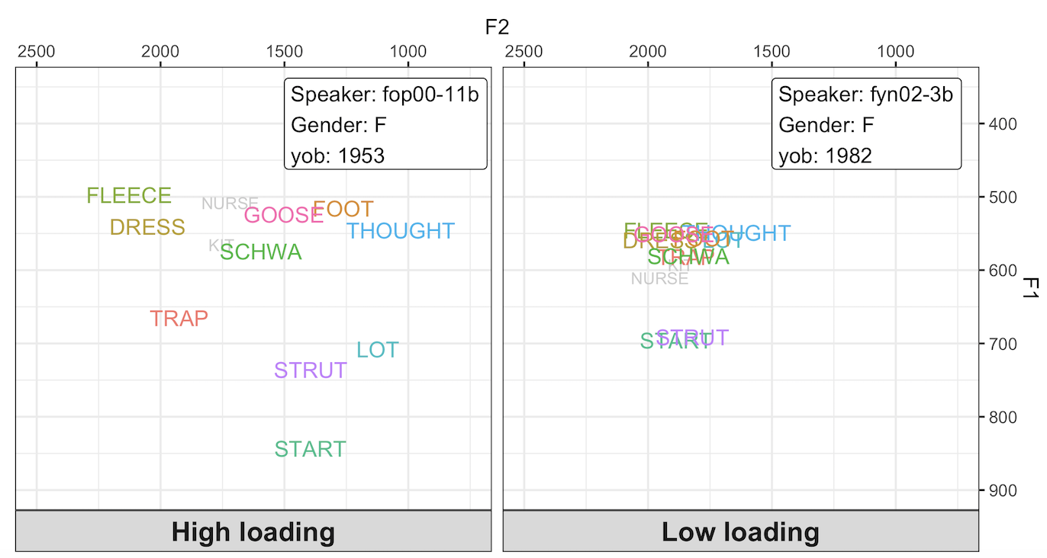
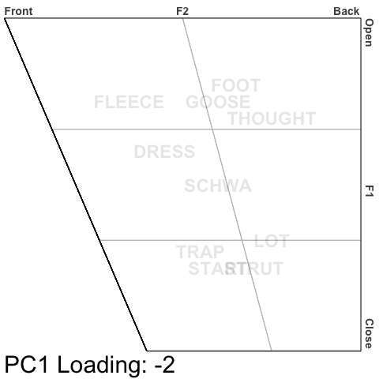
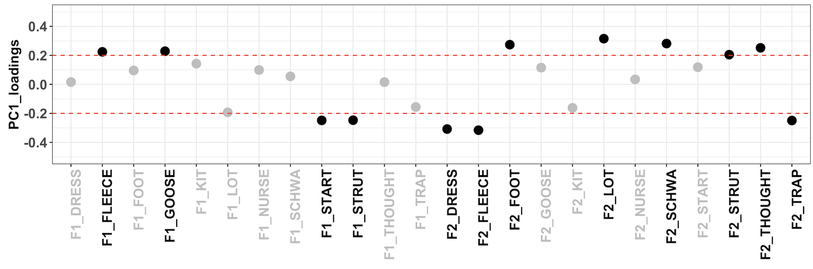
Analysis
PC1 (21.0%) – Vowel space

Slide 10
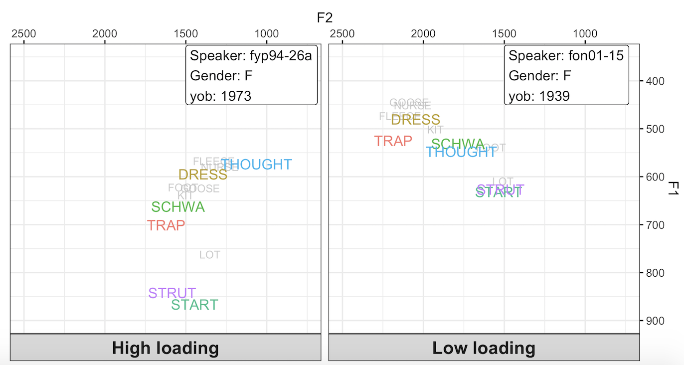
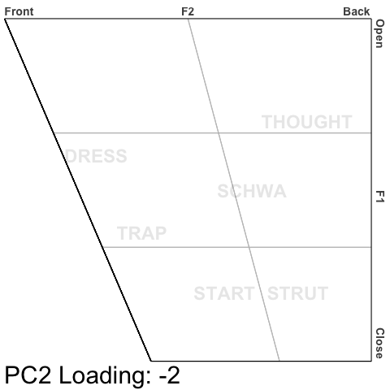
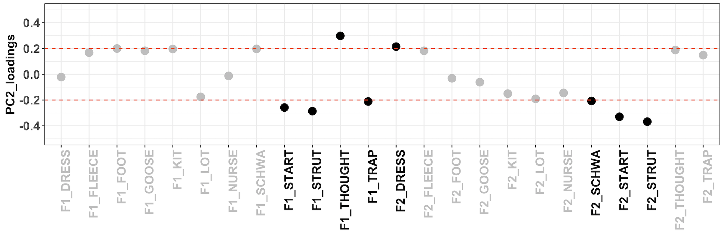
Analysis
PC2 (13.7%) – Further normalisation

Slide 11
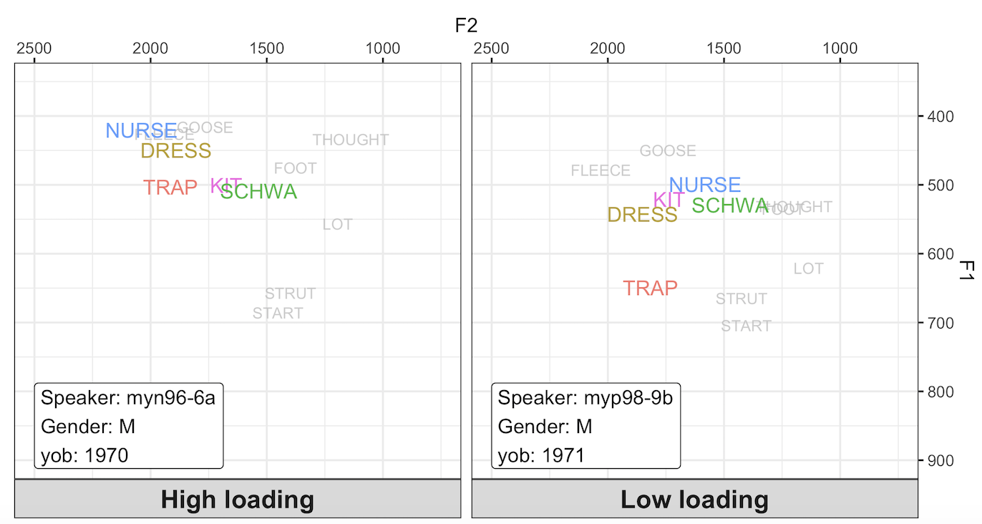
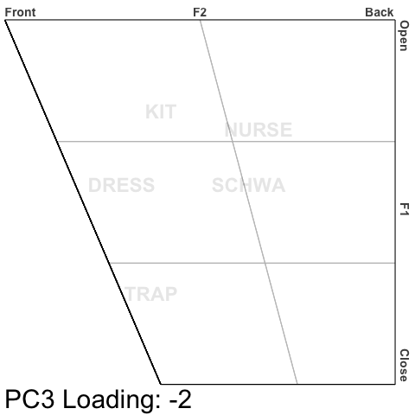
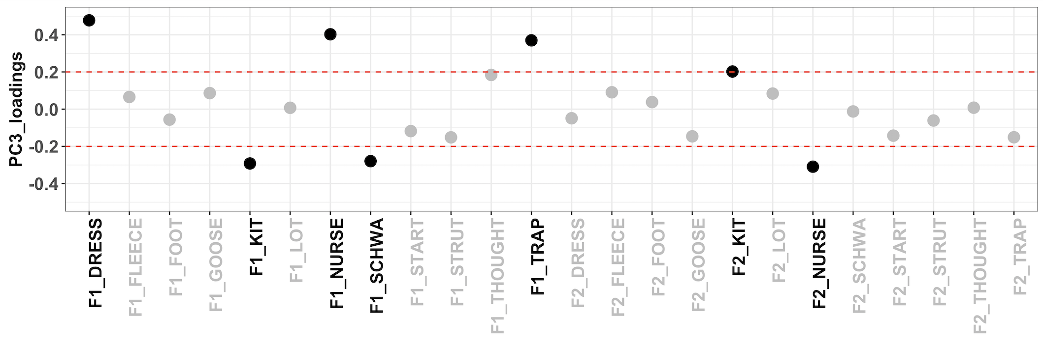
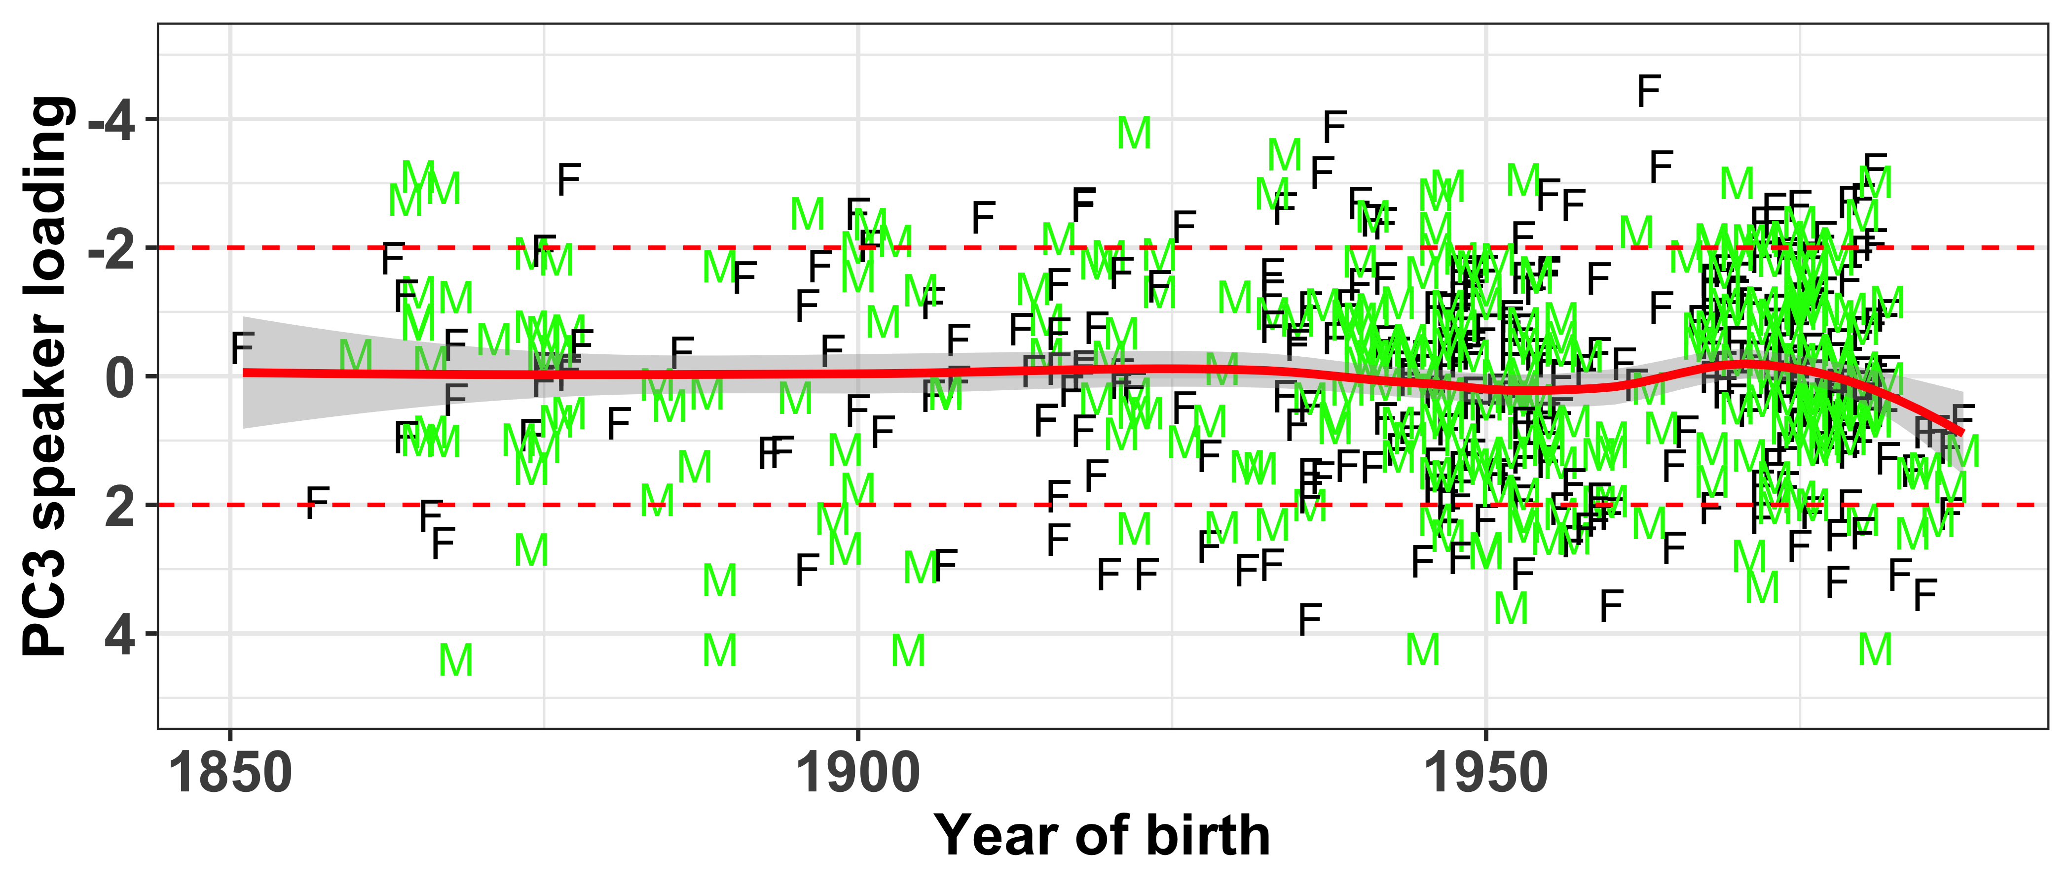
Analysis
PC3 (10.3%) – Leaders and laggers

Slide 12
Discussion
Looking at large scale co-variation across periods of sound change is possible... and interesting
We have a workflow for assessing co-variation across time
This can be applied to other questions/datasets to further explore co-variation and better understand what the linguistic variable is

Slide 13
Thanks
Slides: https://tinyurl.com/icphs-covar
Proceedings paper: https://tinyurl.com/icphs-covar-paper
9th August, 2019
ICPhS, Melbourne
1

